Slide 1
Introduction to Information Technology

Slide 2
Objectives
Define “information” and understand the four methods of representing and conveying information
Describe some important historical milestones in recording and exchanging information
Explain what technical topics are included in the field of information technology

Slide 3
Objectives (continued)
Describe the role information technologies play in modern society
Articulate some cutting-edge trends in information technology
Gain familiarity with current career specializations in information technology

Slide 4
The development of human civilization
agricultural century ( <1800 )
farming using human power
industrial age (1800 - 1957)
working in factories using human power and assisted by machines
information age 1957 - now)
Educated workers
Having special skills to work
Assisted by computers and information technology

Slide 5
Defining Information
Defining “information” are
A fact or series of facts that carry meaning
The value of these facts strongly depends on context
Examples of information
Spam
911 emergency call
Air traffic control map
Text message
Instructions for building a bomb
Sports scores

Slide 6
The Various Forms of Representing Information
The routes to representing information have not changed for centuries
Spoken word (sound)
Text
Pictures -----------------> video
Numbers
Today, information technologies (e.g. Web sites) still represent information with text, images (including video), numbers, and sound

Slide 7
How Historically Have Humans Conveyed Information?

Slide 8
Image Technology Milestones

Slide 9
Sound Technology Milestones

Slide 10
Alphanumeric Technology Milestones

Slide 11
What’s make information usefull
Accuracy
Conprehensive
Flexible
Easy to access
Based on fact
On time

Slide 12
The Speed and Scope of Information
What has changed is the speed and scope of information technologies
Consider what a people can do in an hour:
Check out the day’s most viewed videos on YouTube
Make two cell phone calls
Download a homework assignment for class
Exchange several text messages with friends
Book an airline reservation for a spring break trip
Consult a news source
Download a new music file
Use the electronic library system to reserve a book
Check the day’s sports scores
Play an interactive online game

Slide 13
Defining Information Technology
Information technologies are systems of hardware and/or software that capture, process, exchange, store, and/or present information using electrical, magnetic, and/or electromagnetic energy
Technologies meeting this definition range from digital cameras to Internet radio to corporate computer networks

Slide 14
Two IT Examples
Two examples of information technologies that capture, process, exchange, store, and present information:
Cellular telephony
Wireless Internet access

Slide 15
Cellular Telephony

Slide 16
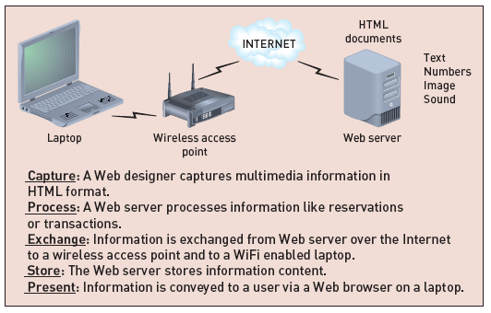
Wireless Internet Access

Slide 17
IT capabilities
Information technology is a description of technology which make people are able to:
Record
Store
Process
Retrieve
Transmit
Receive

Slide 18
What is IT Devices
Hanphone ?
Laptop ?
Computer ?
Internet ?
Or Others?
You Name it..

Slide 19
Data VS Information
Data is raw, unorganized facts that need to be processed. Data can be something simple and seemingly random and useless until it is organized.
When data is processed, organized, structured or presented in a given context so as to make it useful, it is called information.

Slide 20
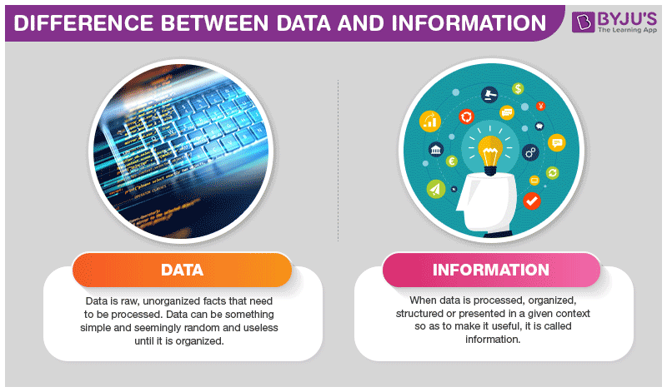
Data VS Information
https://byjus.com/biology/difference-between-data-and-information/

Slide 21
What Is Technology?
Technology is a body of knowledge devoted to creating tools, processing actions and the extracting of materials.
The term ‘Technology” is wide, and everyone has their way of understanding its meaning.
We use technology to accomplish various tasks in our daily lives
in brief; we can describe technology as products and processes used to simplify our daily lives. We use technology to extend our abilities, making people the most crucial part of any technological system.

Slide 22
The used of Technology
Apply technology in almost everything we do in our daily lives;
use technology at work,
use technology for communication, transportation, learning, manufacturing, securing data, scaling businesses and so much more.
Technology is human knowledge which involves tools, materials, and systems. The application of technology typically results in products.

Slide 23
How do we get the informaton
Library
Media
Paper
Telecomunication devices
Othe electronic devices

Slide 24
IT Component
Hardware
CPU, I/O Devices, Cable
Software
OS, application
-Firmware
ROM Instruction
-Brainware
Enduser, programmer, analyst system
-Infoware
-Manual, SOP

Slide 25
Working environment
Fast
Complex
Connected Globally
Competitive advantage
Focus on service excellent
Using Information Technology as The Solution

Slide 26
IT-Enabled Activities
People rely on information technology for entertainment, communication, and a variety of day-to-day functions
Most national economies are enmeshed in information technologies
IT has improved government communications and information sharing

Slide 27
IT-Enabled Activities for People: Personal Communications
Conversations via phones and cell phones
Messaging via e-mail and text messages
Video communications

Slide 28
IT-Enabled Activities for People: Entertainment
Surfing the Web
Listening to the radio
Downloading MP3 files
Watching television
Playing interactive games

Slide 29
IT-Enabled Activities for People: Day-to-Day Living
Buying an airline ticket
Ordering books
Checking the weather forecast or news
Electronic banking
Investing in the stock market

Slide 30
IT-Enabled Activities for Businesses: Internal Communications
Internal computer networks
Internal corporate Web sites
Video teleconferencing
Phone systems, cell phones, voice mail
Messaging via e-mail and text messaging

Slide 31
IT-Enabled Activities for Businesses: Electronic Commerce
Call centers
Electronic transactions with suppliers
Online sales
Point of sale devices and networks
Customer transaction servers

Slide 32
IT-Enabled Activities for Businesses: Business Operations
Factory floor systems
Inventory tracking systems
Customer databases
Payroll and human resources

Slide 33
IT-Enabled Activities for Universities
University phone systems
Messaging via e-mail and text messages
University Web site
Electronic course schedules
Online academic calendar
Electronic classrooms
Library information systems
Online registration
Online applications system
Payroll and human resources

Slide 34
IT-Enabled Activities for Government/Citizen Interaction
Electronic voting systems
Motor vehicle registration
Electronic tax filing
Electronic voting systems
Social Security transactions
Information dissemination

Slide 35
IT-Enabled Activities: Government Functions
Military information systems
Electronic surveillance
Intelligence networks
Air traffic control systems
Internal Revenue Service database
Internal information networks and phone systems
Library of catalogs

Slide 36
The State of IT: Wireless
What’s hot
Being “unplugged”
Wireless LANs (Wi-Fi)
Mobile telephony
What’s not
Being “plugged”
“Dark” fiber
Traditional telephony

Slide 37
The State of IT: Security
What’s hot
Critical infrastructure protection
Firewalls
Biometric authentication
What’s not
Wi-Fi spoofing
Unencrypted transmission
Worms and Viruses

Slide 38
The State of IT: Media-Free
What’s hot
Distributed file sharing
Video downloads
Digital audio files
What’s not
CDs
DVDs
Floppy drives

Slide 39
The State of IT: Interoperability and Openness
What’s hot
Open source code
Interoperable approaches
Open standards
What’s not
Closed source code
Proprietary technology
IM incompatibility

Slide 40
The State of IT: Small Technologies
What’s hot
Mobile devices
Nanotechnology
Distributed processing
What’s not
Personal computers
Macrotechnology
Centralized processing

Slide 41
The State of IT: Convergence
What’s hot
Voice over Internet
Video phones
Multimedia
What’s not
Traditional telephone service
Voice only cell phones
Data only LANs

Slide 42
The State of IT: Speed
What’s hot
Compressed formats
Broadband
Gbps+
What’s not
Uncompressed formats
Dial-up

Slide 43
Reference
Introduction to Information Technology 2nd Edition, 2012, ITL Limited ITL Education Solutions Limited, Pearson Education
Pelin Aksoy, Laura DeNardis,2007, Information Technology in Theory,Thomson Course Technology

Slide 44
1.Teknology addition reading.pptx
2. IS addition reading.ppt

